Slide 1
Topic: Web Based Classroom Seat Allocation System using Django and SQLite3
REVA Academy for Corporate Excellence (RACE)
Date: 24-03-2026
Shashwath K S
MTech in AI FT-Batch 04
Project Presentation
www.race.reva.edu.in

Slide 2
Agenda
01
Introduction
05
Technology Stack
02
Problem Statement
06
System Features and Layout
03
Objectives
07
Future Enhancements
04
ERD and System Design
08
Conclusion

Slide 3


Introduction
A web-based management platform for systematic classroom seat allocation using Django-based relational logic and interactive React components.
Why this System?
Manual seating arrangements are error-prone and tedious.
Difficult to handle overlapping schedules and mentor availability.
Fixed room layouts require dynamic capacity calculations.
Need for a centralized system to ensure data integrity and validation.
Physical charts lack real-time visibility and easy synchronization.

Slide 4
Problem Statement
Problem Statement:
Manual allocation results in frequent scheduling and room conflicts.
Difficulty in managing diverse layouts (Regular, Lab, Conference).
Lack of direct validation for mentor availability and room capacity.
Fragmented data storage leading to inconsistency and reporting errors.
Proposed Solution:
Centralized Django-SQLite platform for structured institutional data.
Real-time validation engine to prevent double-booking of resources.
Interactive React dashboards for visual seating and batch management.
Digital-first workflow to ensure data integrity and scheduling accuracy.

Slide 5
Objectives
To design a relational database system for managing students, batches, classrooms, mentors, and session schedules using structured DBMS concepts.
To enforce database-level constraints to prevent conflicts such as multiple classroom assignments, mentor overlap, duplicate batch scheduling, and capacity overflow.
To ensure accurate session management by validating allocations based on student count, classroom capacity, mentor availability, date, and time-slot rules.

Slide 6
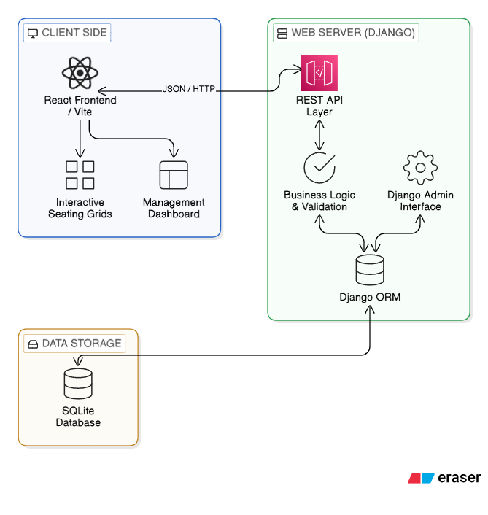
System Architecture Design

Slide 7
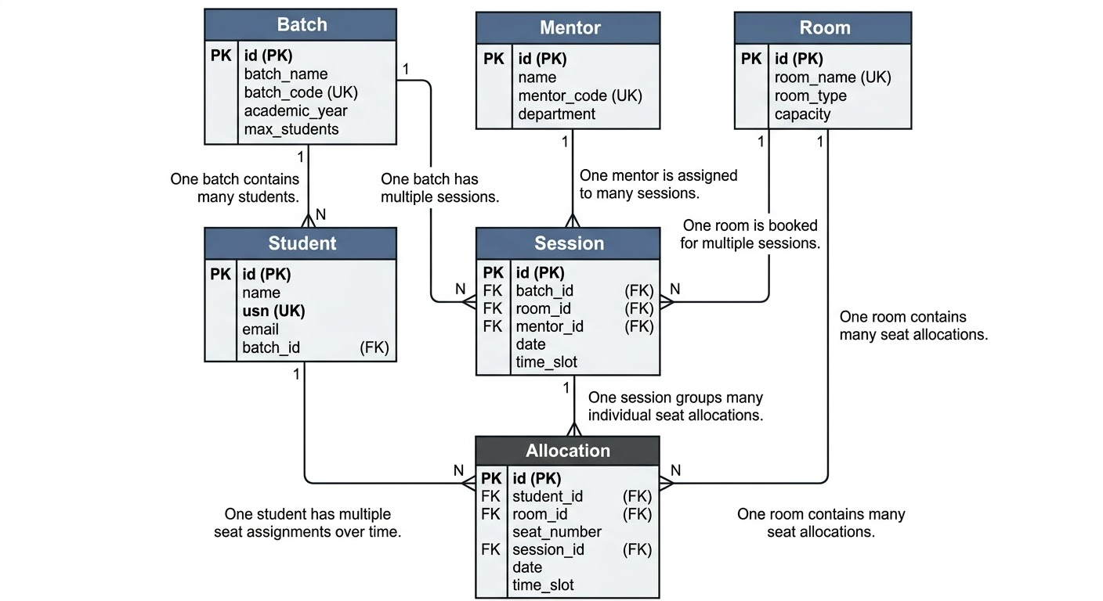
DB Structure

Slide 8
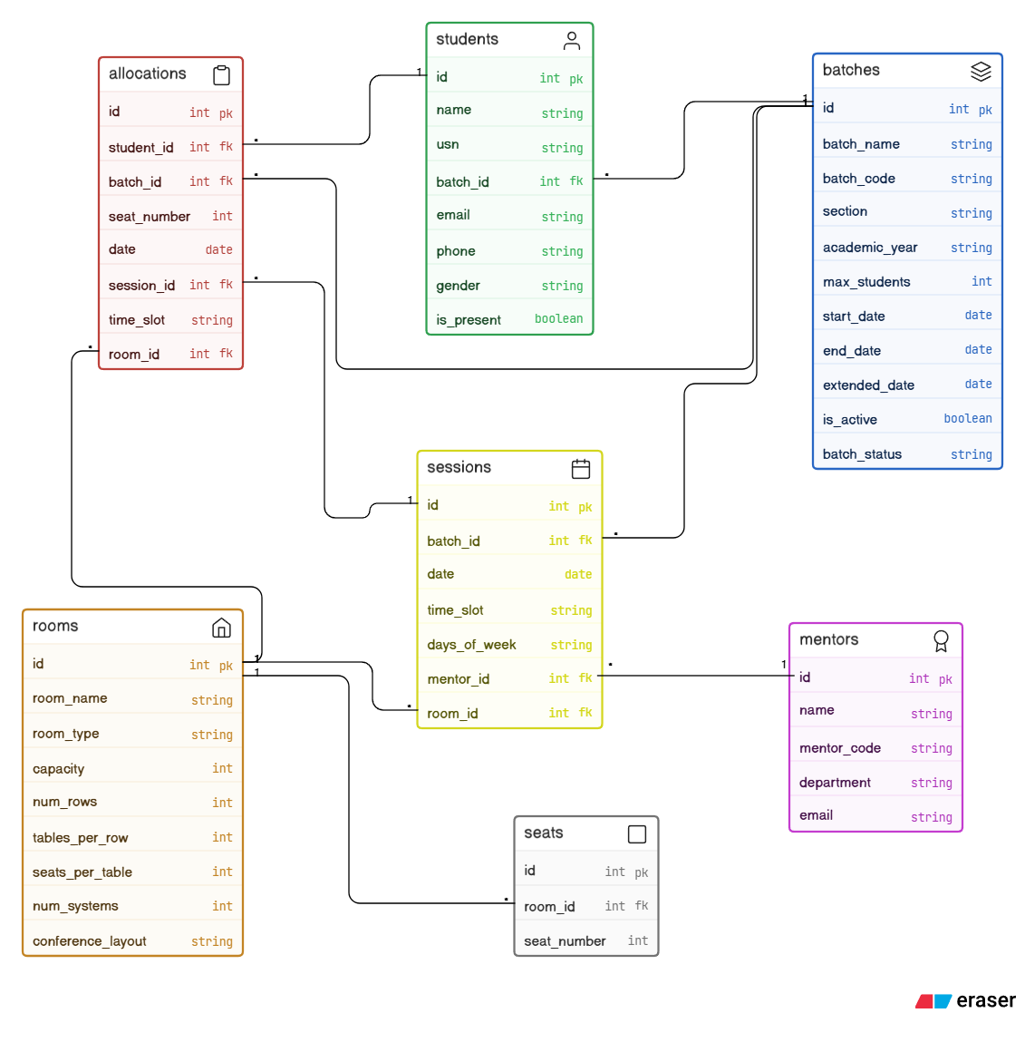
DB Structure

Slide 9
Technology Stack
Technology stack
Backend Framework | Django (Python)
Database Engine | SQLite (Relational DBMS)
Frontend Library | React (Vite-powered)
UI Components | Lucide-React & Custom CSS
API Architecture | REST API (Django REST Framework)
Development Tools | npm/pip & VS Code

Slide 10
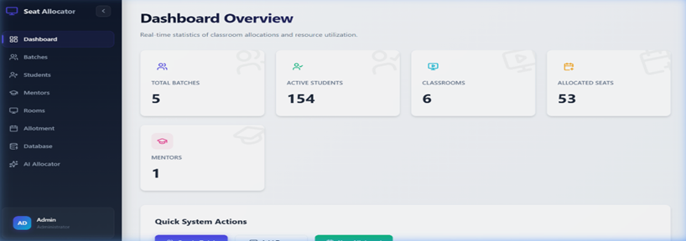
Demo and modes
The Application
Dashboard view of the Application

Slide 11
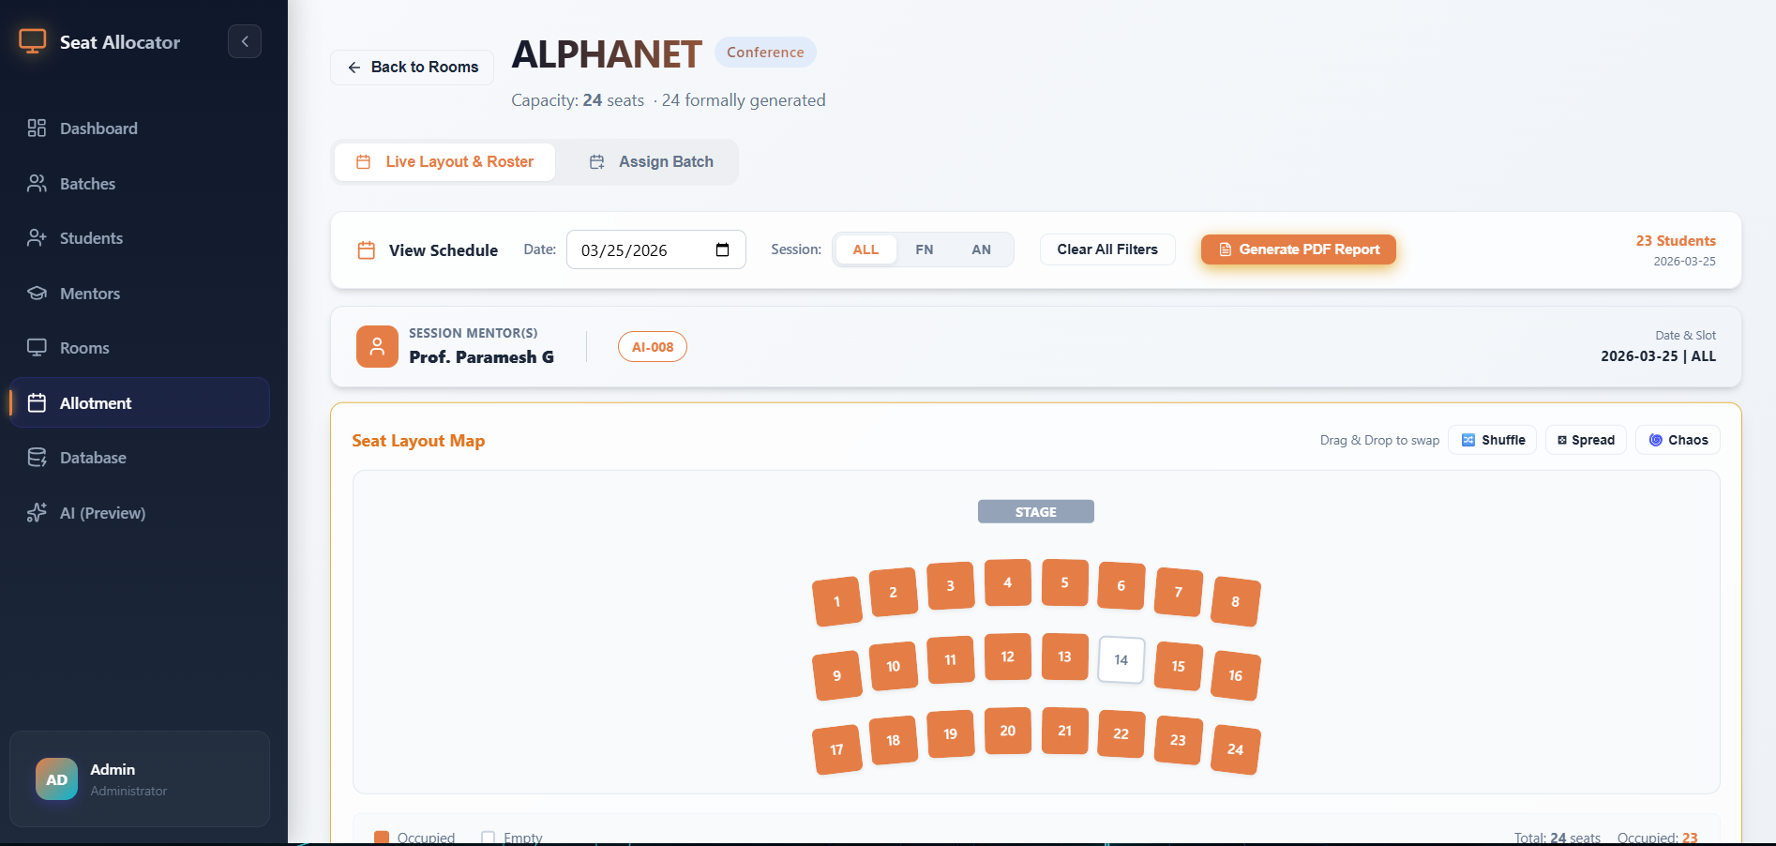
Demo and modes
Preview of the Classroom type “Conference”

Slide 12
Future Enhancements
Develop
Develop a mobile application for real-time seat lookup and session notifications.
Implement
Implement an AI-driven layout optimizer for advanced classroom resource planning.
Expand
Expand system support to include automated examination hall ticket generation.
Support
Support for cross-departmental scheduling sync with institutional ERP systems.

Slide 13
Conclusion
Digital seat management bridges the gap between complex scheduling and institutional efficiency. Our platform simplifies administrative workflows by replacing manual plotting with a robust, relational interface. Future enhancements like biometric integration and AI-driven layout optimization will further scale this innovation. We remain dedicated to ensuring resource management is accurate, accessible, and effortlessly maintained.

Slide 14


